Slide 1


BACKEND

Slide 2
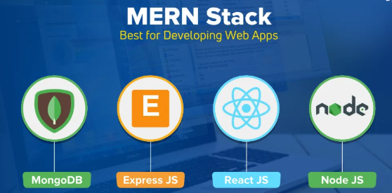

Slide 3
CLASS 1: INTRODUCTION TO BACKEND & NODE.JS BASICS

Slide 4
1. What is Backend?

Slide 5
1. What is Backend?
Definition:
The backend is the server-side part of a web application that handles logic, database interactions, authentication, and communication with the frontend.

Slide 6
What is a Server?
A server is a computer program (or system) that listens for incoming requests (like from a browser or mobile app), processes them, and then sends back a response (like data or a web page).
In the MERN stack, the server is usually built using Node.js + Express.

Slide 7


Slide 8
2. What is Node.js?
Node.js is a JavaScript runtime built on Chrome's V8 engine that allows you to run JavaScript code outside the browser, primarily for server-side logic.

Slide 9
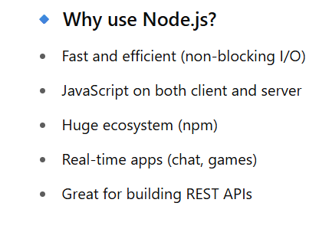

Slide 10
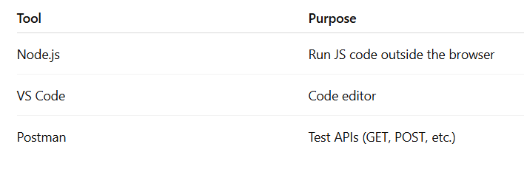
3. Setup: Node.js, VS Code, Postman

Slide 11
5. npm init & CommonJS Modules
Q. What is npm?
npm (Node Package Manager) is used to install libraries and manage dependencies.

Slide 12
6. Built-in Node.js Modules
fs – File System
path – File Paths
http – Create HTTP server

